Slide 1


The Impact of Diabetes Percentage and Human Development Index (HDI) on COVID-19 Death Cases in 2020: A Study on Global Trends Abdulbaset Alzhrani CHE 2410 | Project 1

Slide 2
Outline
Introduction and Background
Result and Discussion
Conclusion
Recommendation

Slide 3
Introduction and Background
COVID-19 affects people of all ages, but people with preexisting health conditions (diabetes for example) are at a higher risk. Additionally, the Human Development Index (HDI) of a country plays a major role in determining its ability to prevent, diagnose, and treat COVID-19 cases.
The primary aim of this study is to conduct a comparative analysis of the correlation between diabetes prevalence and HDI among COVID-19 fatalities.

Slide 4
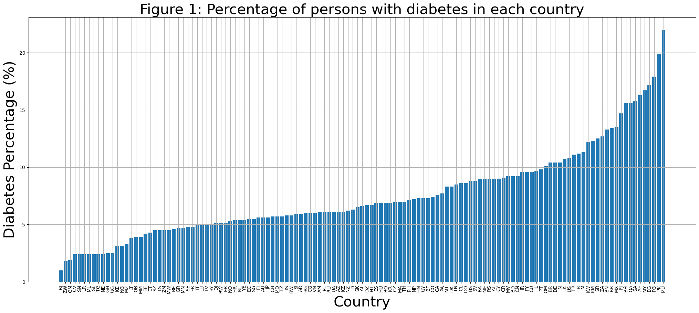
Introduction and Background

Slide 5
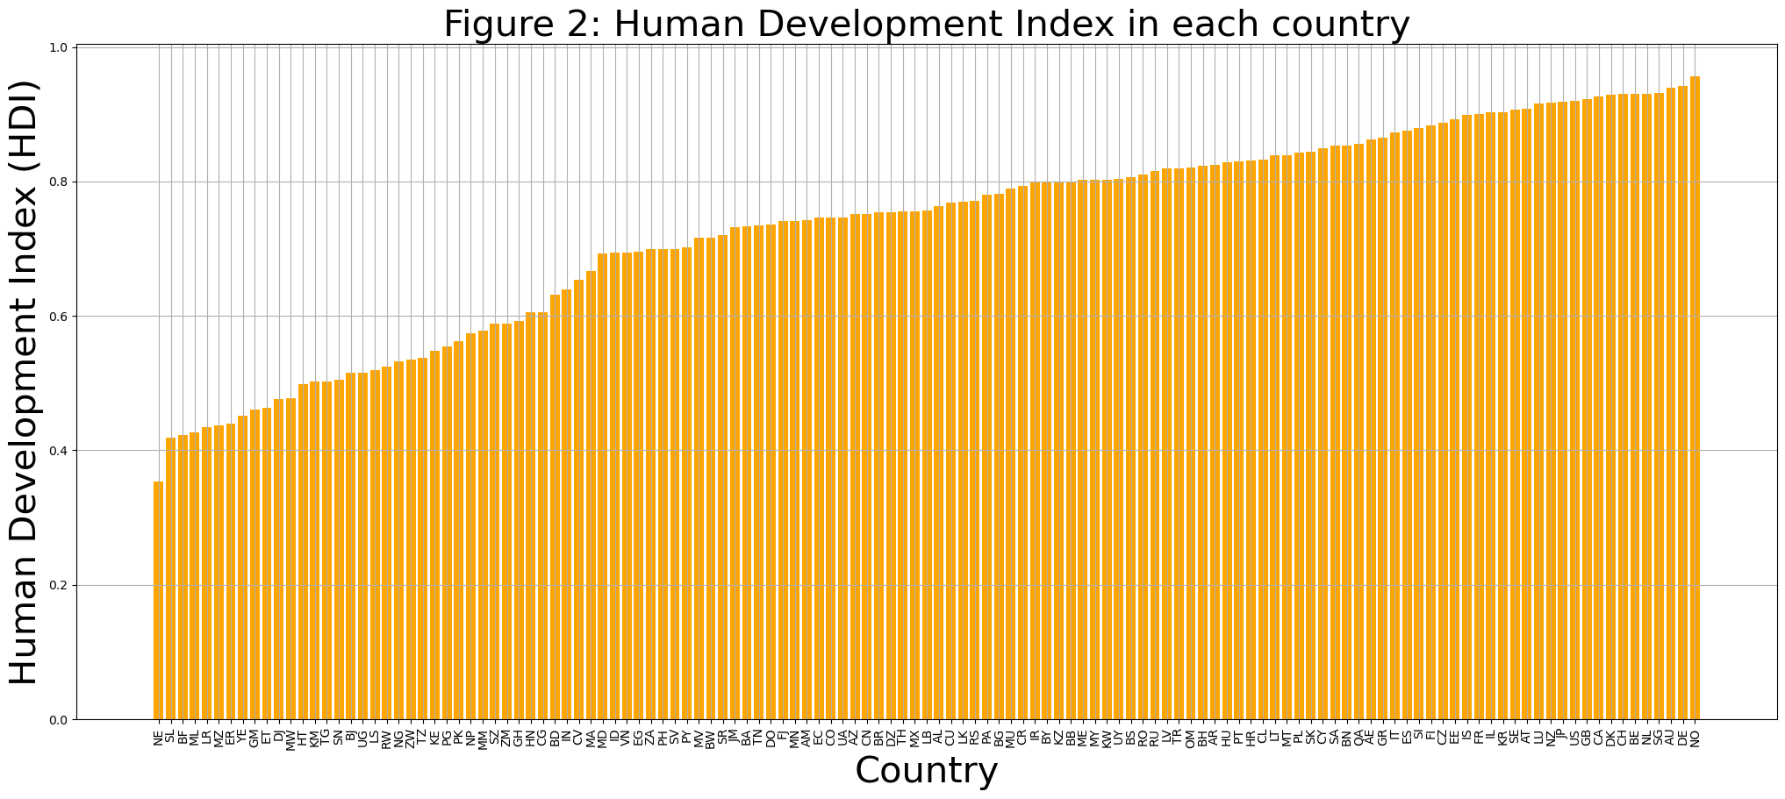
Introduction and Background

Slide 6
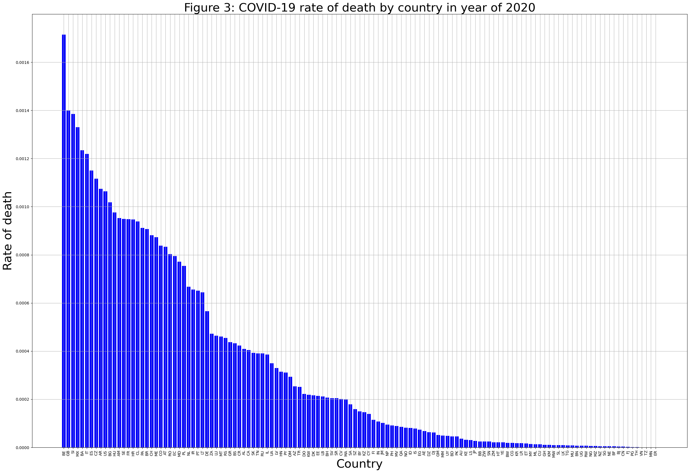

Introduction and Background
$$Deat rate=$$
$$\frac{cumulative death cases in 2020}{Country population}$$

Slide 7
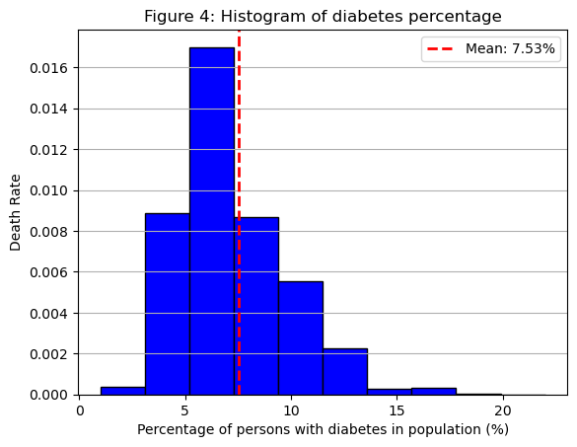
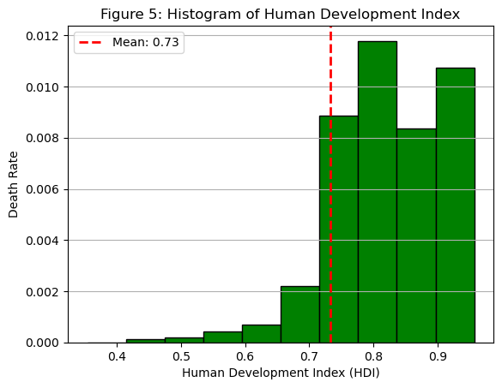
Result and Discussion

Slide 8
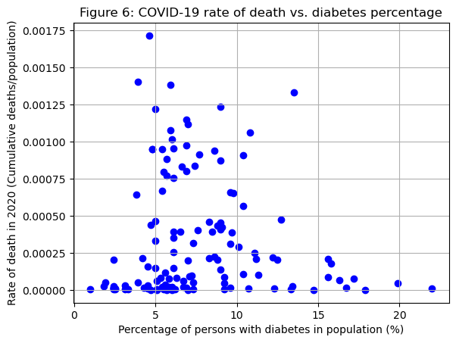
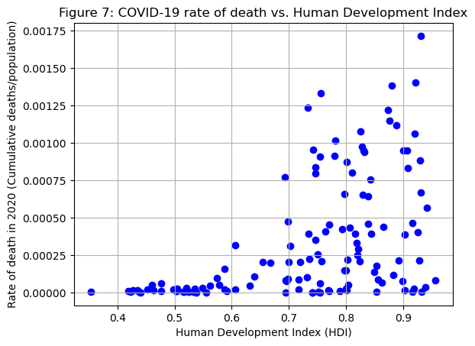
Result and Discussion

Slide 9
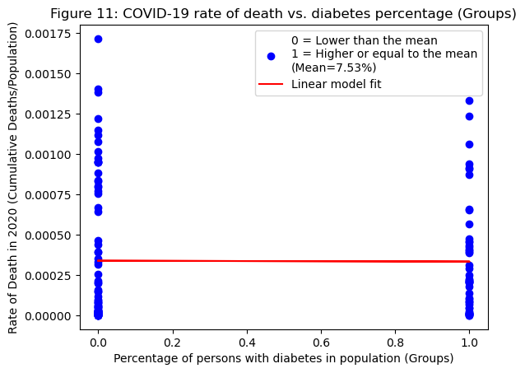
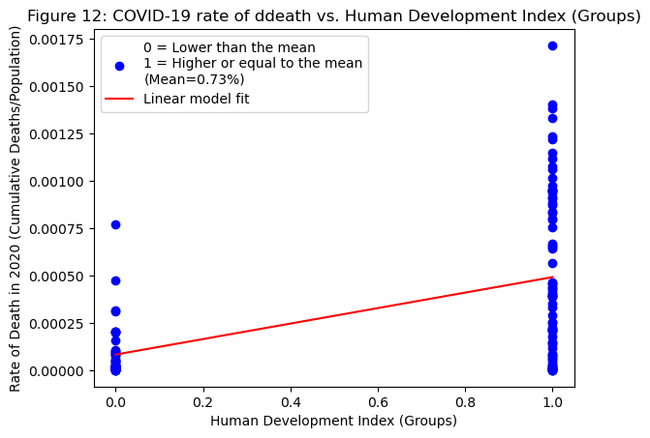
Result and Discussion
The intercept is 0.0003384 and the slope is -5.172e-06
The intercept is 8.3147e-05 and the slope is 0.0004084

Slide 10
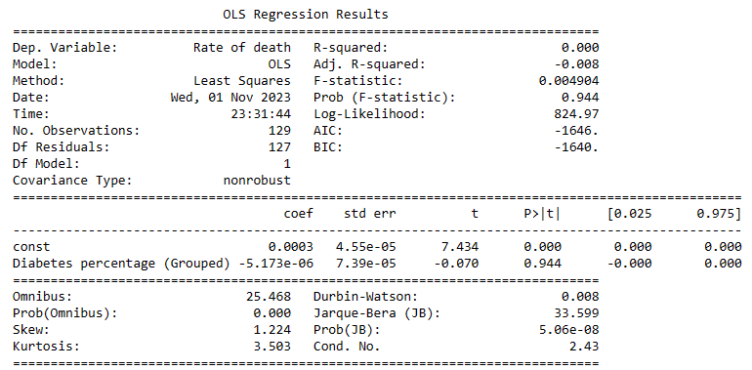
Result and Discussion

Slide 11
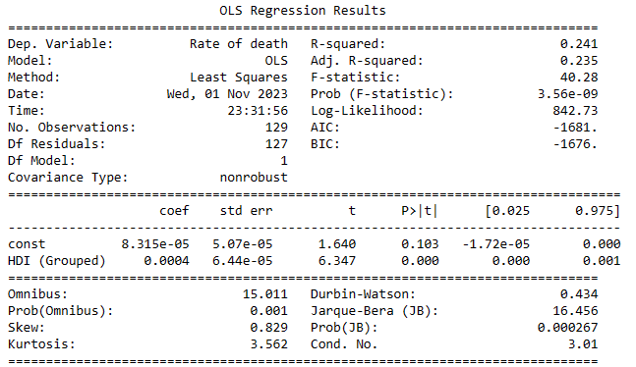
Result and Discussion

Slide 12
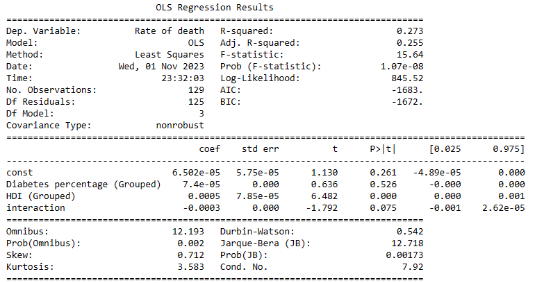
Result and Discussion
$$Deat rate=7.4e−05Di+0.0005HDI − 0.0003Di∗HDI+6.502e−05$$

Slide 13
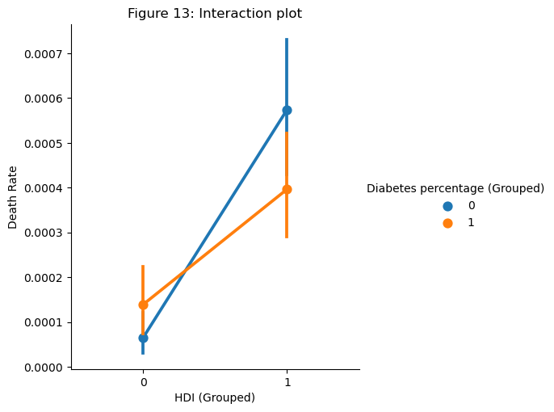
Result and Discussion

Slide 14
Conclusion
HDI has a significant positive impact on COVID-19 death cases.
Diabetes Percentage does not have a significant impact on COVID-19 death cases.
The interaction between Diabetes Percentage and HDI has a negative impact on COVID-19 death cases but is not significant at the conventional level (p-value=0.075).

Slide 15
Recommendation
Genetic variants may also contribute to the risk of severe COVID-19 disease.
Studying different type 1 and 2 of diabetes separately could provide valuable insights into the impact of diabetes on COVID-19 outcomes.
It is important to consider countries with high credibility requirements for their record-keeping systems in order to ensure reliable data.

